Slide 1
DC Circuit SIMULATOR using Object-Oriented Programming and Tkinter GUI
Submitted By:
Abhinav Pradeep (CB.EN.U4ELC24004)
Shravan S Sudhir (CB.EN.U4ELC24040)
Varun Ladda (CB.EN.U4ELC24062)
Jayanth P (CB.EN.U4ELC24027)

Slide 2
Abstract
This project develops an object-oriented framework in Python to perform DC circuit analysis on networks comprising resistors and voltage sources, leveraging Modified Nodal Analysis (MNA) for efficient computation. The system models circuit elements using inheritance and polymorphism, features a user-friendly GUI built with Tkinter, and dynamically computes node voltages and branch currents, demonstrating the integration of OOP principles into electrical engineering computation.

Slide 3
Overview of the Project
• A Python-based circuit solver built using Object-Oriented Programming (OOP) • Uses Modified Nodal Analysis (MNA) for solving DC electrical circuits • Components include Resistors and Voltage Sources • Provides a user-friendly GUI for circuit creation and analysis • Displays node voltages and component currents

Slide 4
Object-Oriented Design
• Base Class: CircuitComponent defines a common interface for all components • Derived Classes: - Resistor: Implements Ohm's law and conductance stamping - VoltageSource: Adds equations for voltage sources and calculates current • Circuit Class: Manages all components, nodes, and solving process • CircuitGUI Class: Provides the graphical interface using Tkinter

Slide 5
Working Principle Modified Nodal Analysis
1. User adds circuit components (Resistors and Voltage Sources) 2. The system builds nodal equations using Modified Nodal Analysis (MNA) 3. Matrix formulation: [G][x] = [I] - G: Conductance matrix - x: Unknown voltages and source currents - I: Current/voltage vector 4. Solves using NumPy linear algebra solver 5. Results are displayed as node voltages and component currents

Slide 6
Graphical User Interface (GUI)
• Built using Tkinter and ttk modules • Tabs for adding Resistors and Voltage Sources • Real-time component list display • Buttons for Solve, Clear, and Save Results • Error handling for invalid or unsolvable circuits

Slide 7
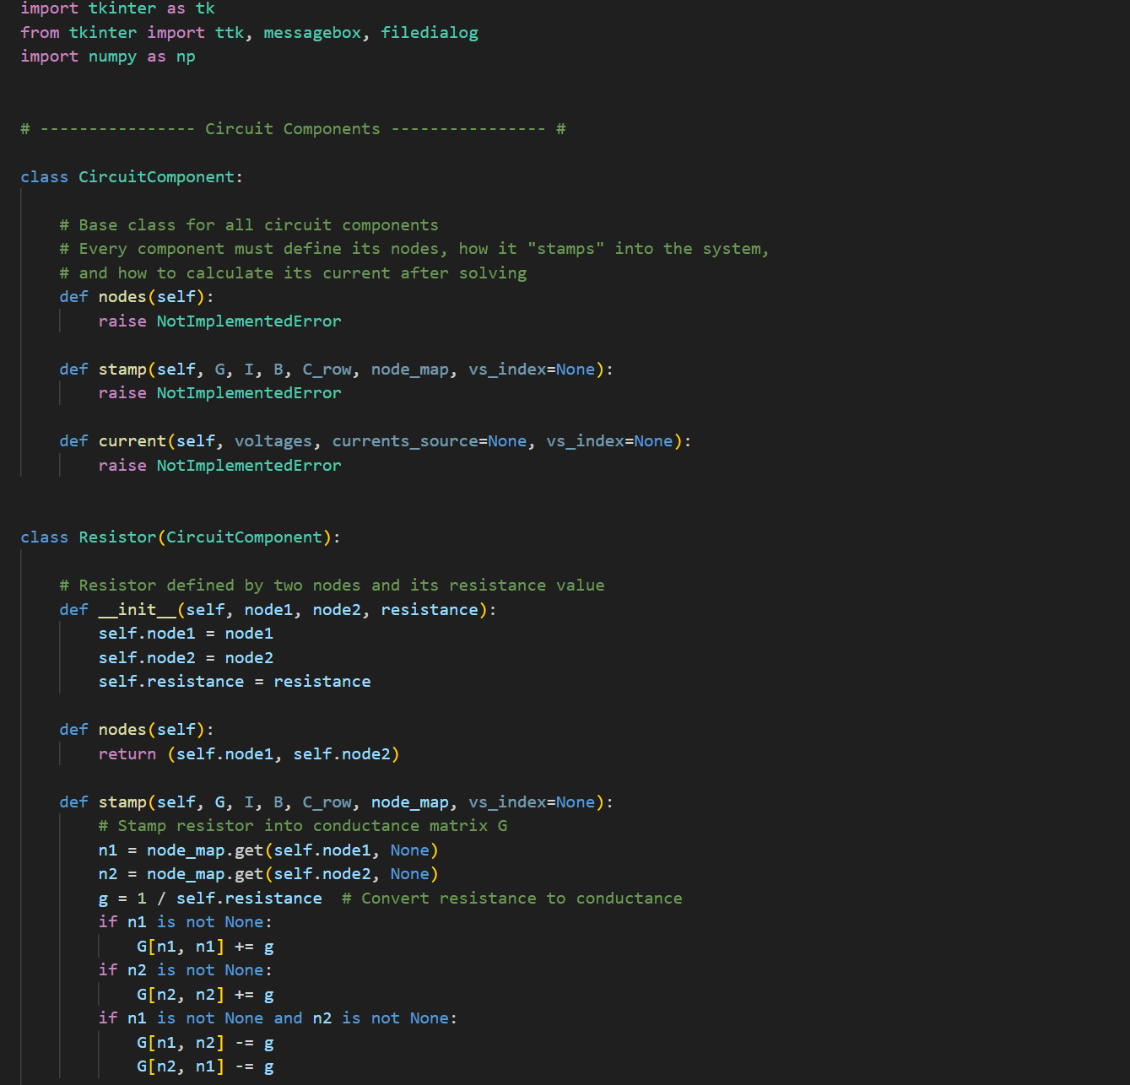
CODE

Slide 8
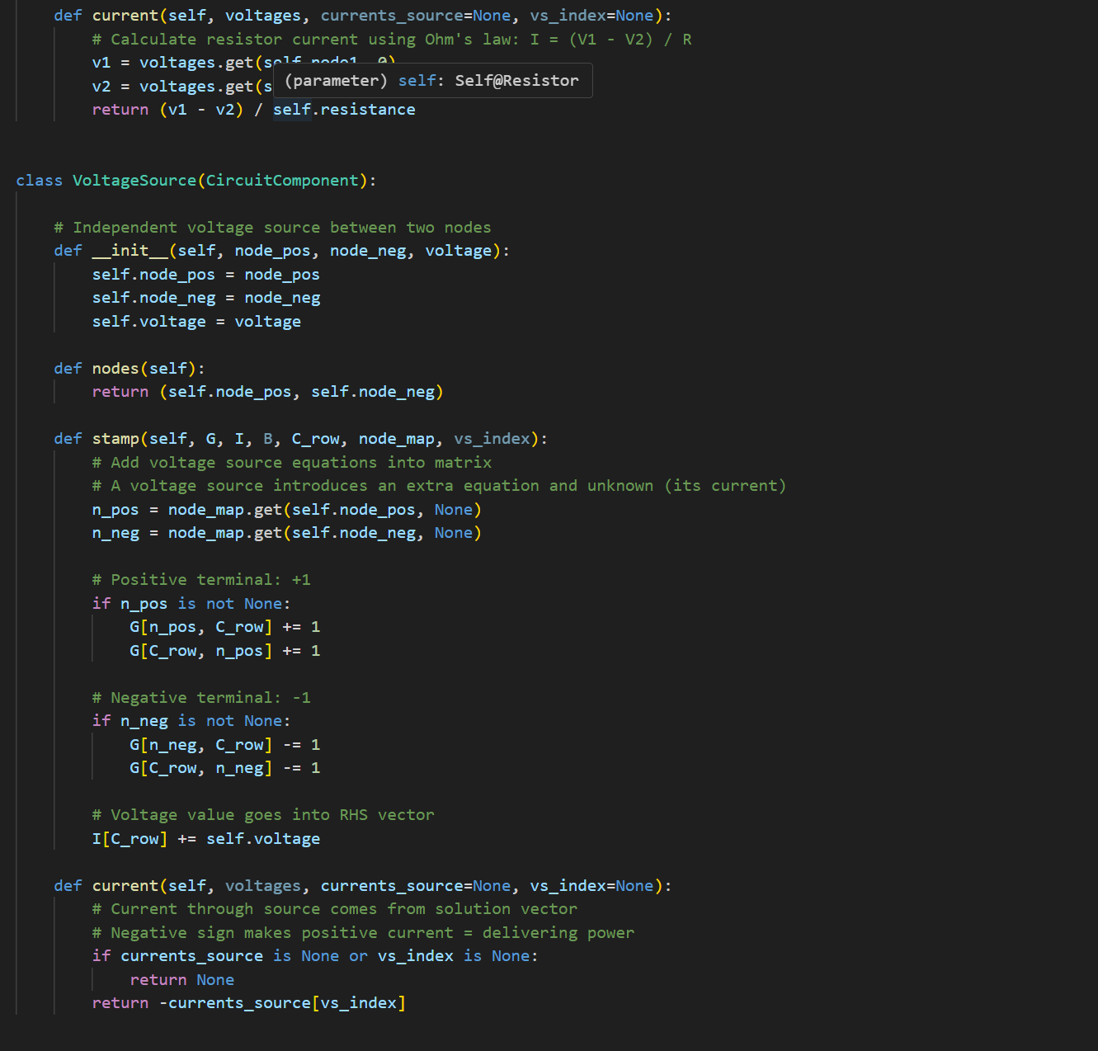

Slide 9
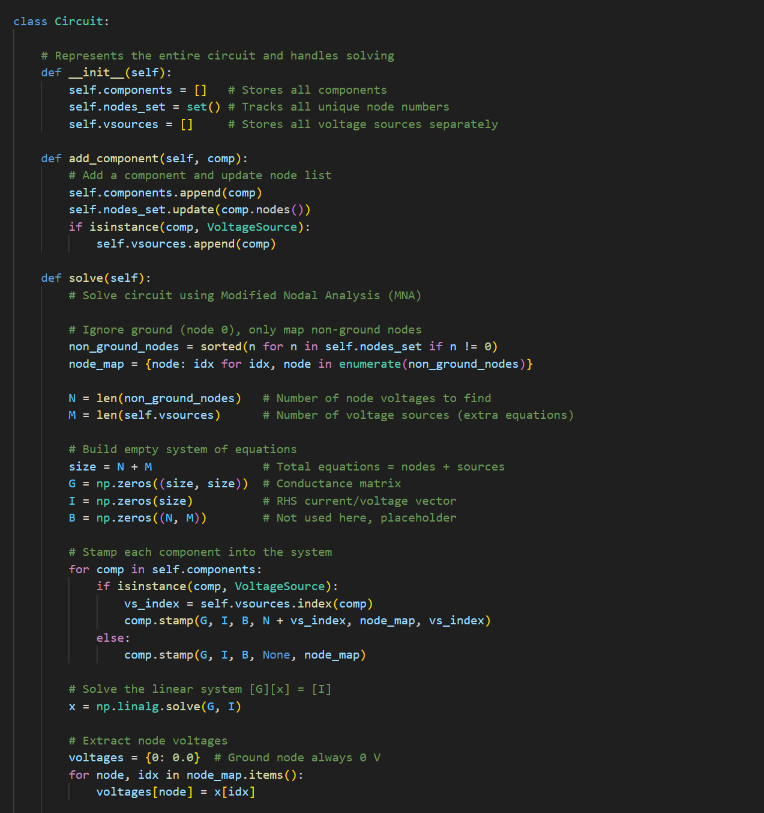

Slide 10
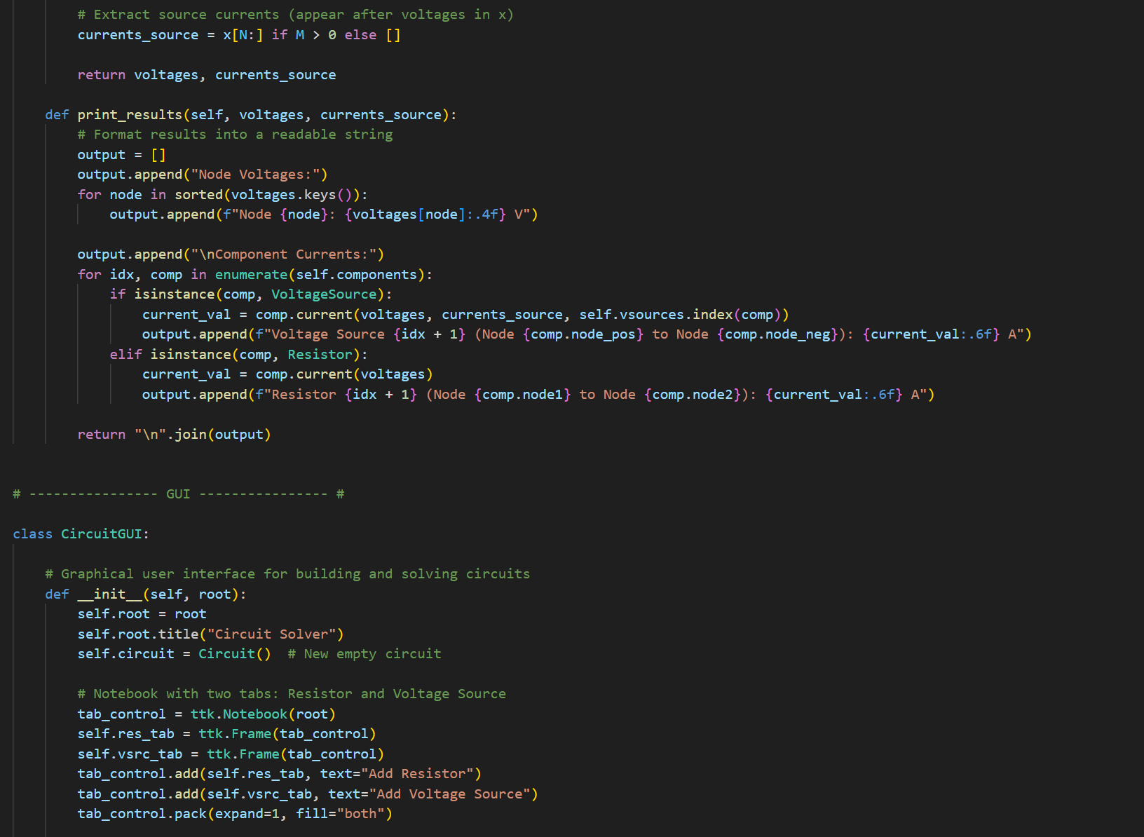

Slide 11
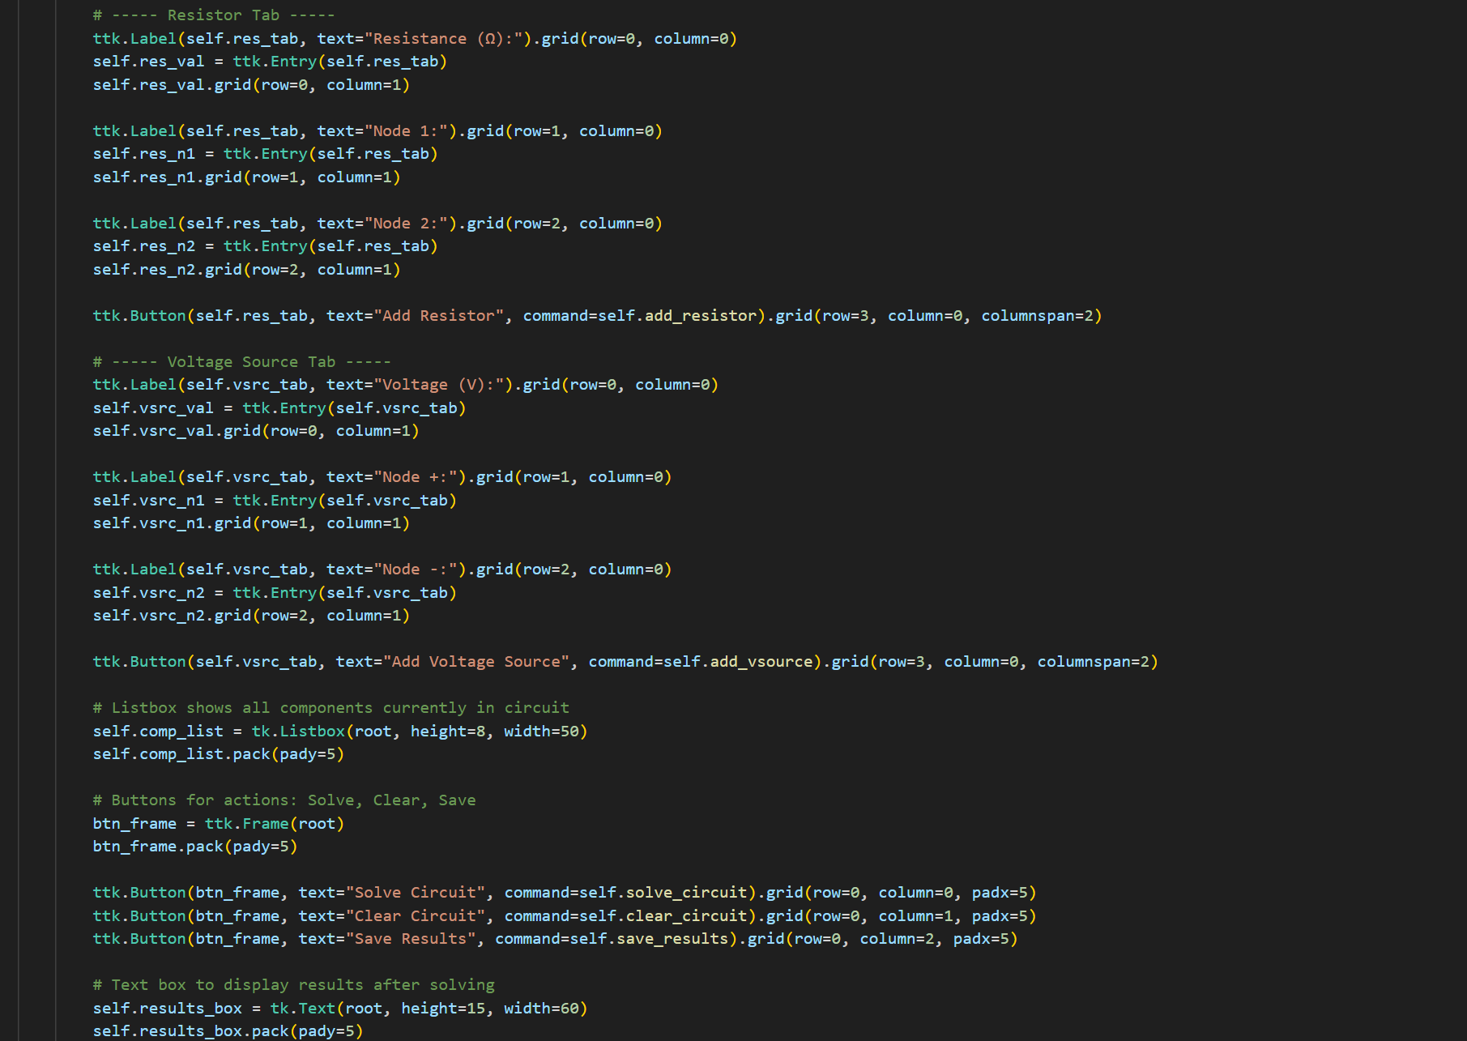

Slide 12
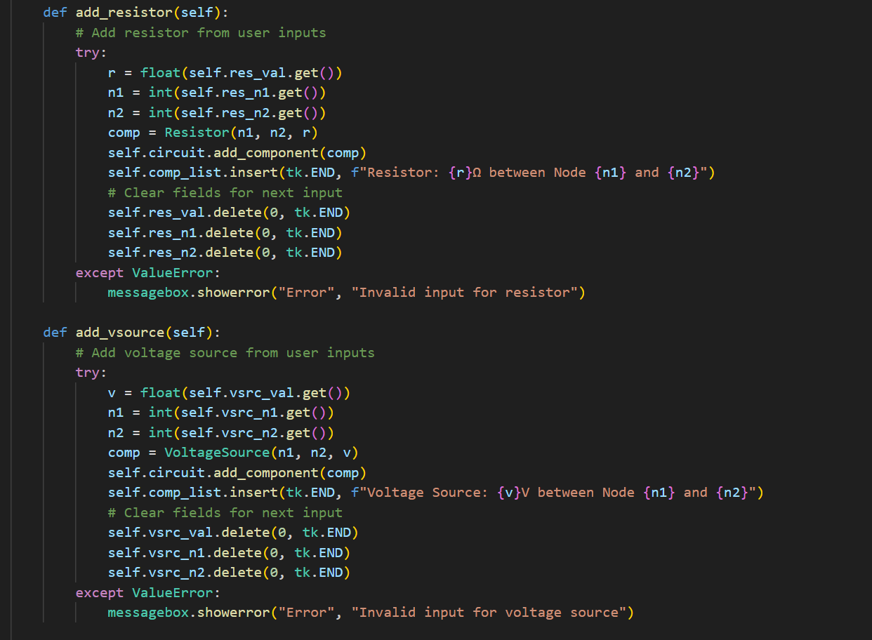

Slide 13
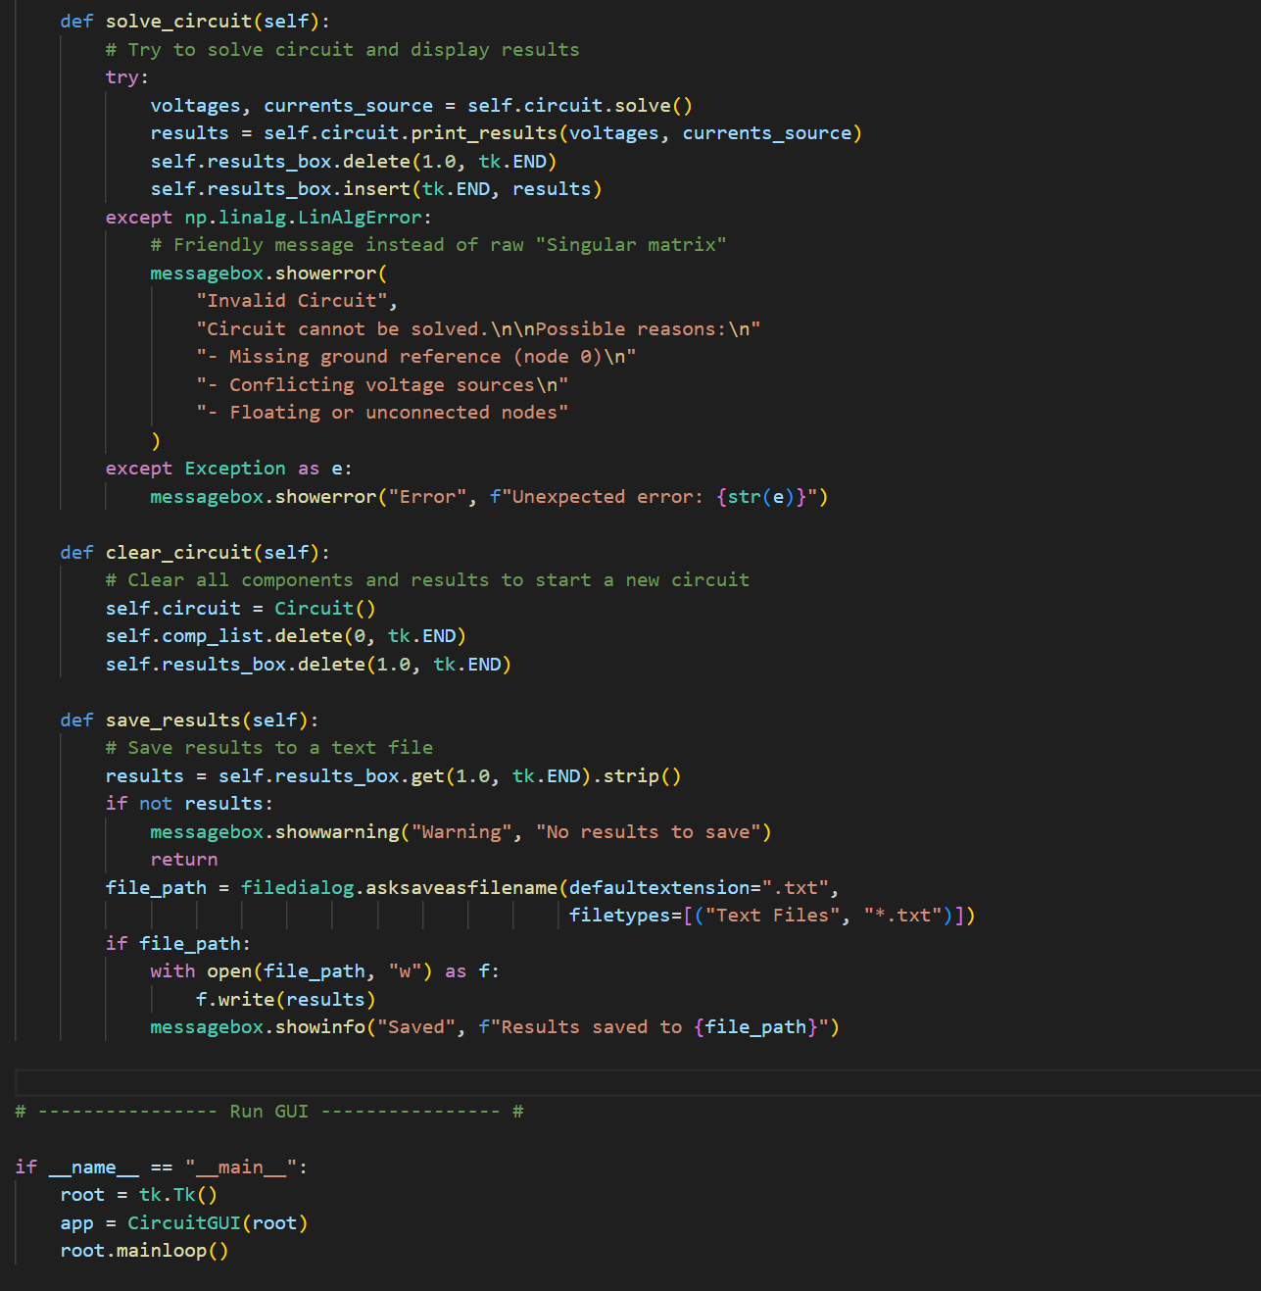

Slide 14
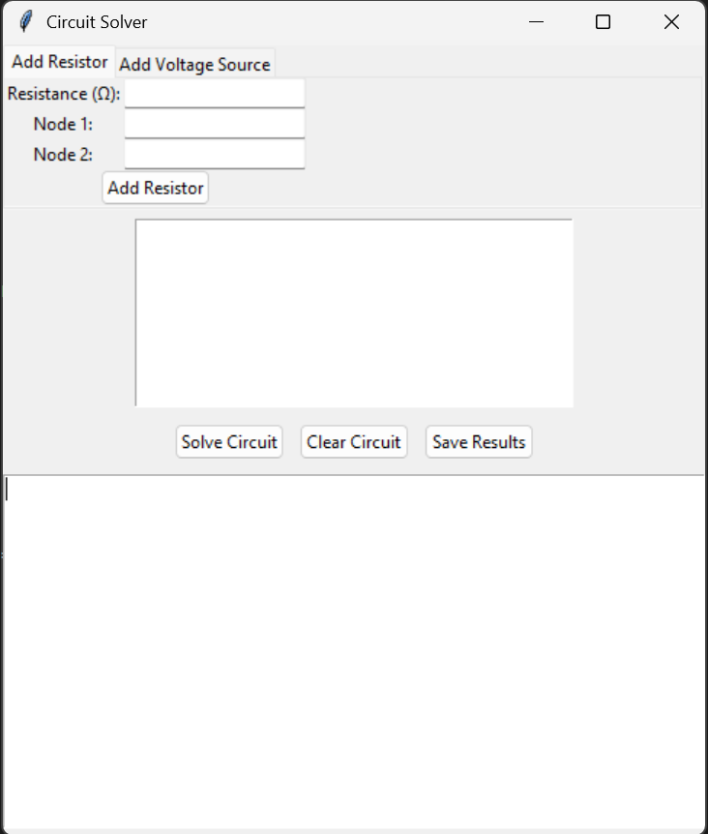
OUTPUT

Slide 15
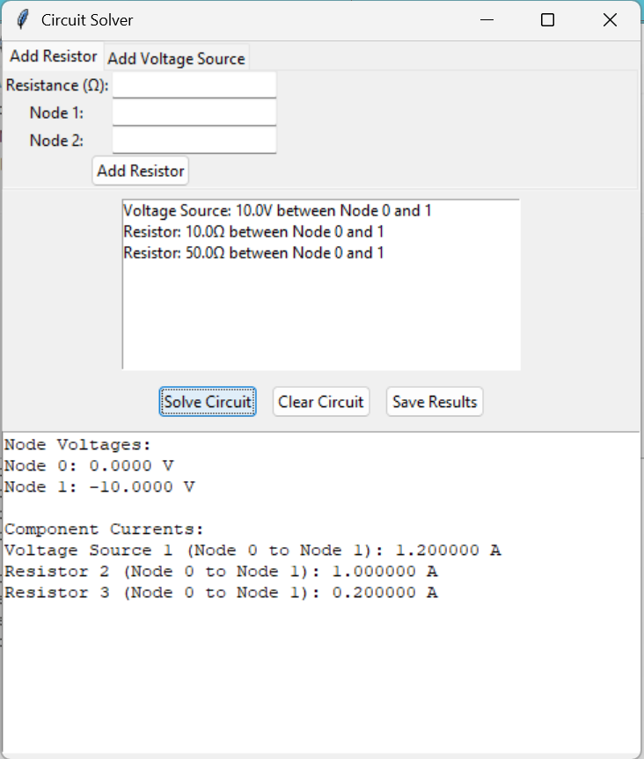

Slide 16
Applications
• Educational tool for learning circuit analysis • Demonstrates OOP design in engineering computation • Can be extended to include dependent sources, capacitors, inductors • Useful for validating small DC circuit designs • Foundation for more advanced simulators (SPICE-like tools)

Slide 17
Advantages of Object-Oriented Approach
• Code reusability through inheritance • Easy scalability — new components can be added with minimal changes • Clear separation of concerns between components, solver, and GUI • Easier debugging and testing due to modular structure • Enhances readability and maintainability

Slide 18
Conclusion
This project demonstrates how Object-Oriented Programming can be applied to solve real-world engineering problems using computational techniques. The integration of MNA with a Tkinter-based GUI makes circuit analysis intuitive, educational, and adaptable for further research and application.

